Slide 1
Weekly report: Tower structure
Week number: 02
Date: 30/09/2025
Supervisor: Prof. Faber
Group members: Ibrahim Mostafa, Mohammed Eldemerdash, Kirolls Ghaly
Speaker: Mohammed Eldemerdash (760137)

Slide 2
List of contents
Obstacles of the Transportation, for choosing the Tubular Steel structure.
Solutions to overcome transportation of the steel tower .
Handwritten load calculations and stress analysis based on data from NREL for a wind turbine with similar data.
Group members: Ibrahim Mostafa, Mohammed Eldemerdash, Kirolls Ghaly
Tower structure team/ Optimus Syria

Slide 3
1. Obstacles of the Transportation, for choosing the Tubular Steel structure.
Design vertical clearance (treaty): 4.90 m
Assume low-loader deck 0.80 m + 0.15 m tolerance ⇒ Max tower section Ø ≈ 4.0 m (route survey still required).
Ref:
AGREEMENT ON INTERNATIONAL ROADS IN THE ARAB MASHREQ
https://treaties.un.org/doc/source/RecentTexts/11_B_33E.pdf
the diameter at the bottom of the tower is 6m.
→ So transporting the Tower would be impossible using the highways in Syria.
Group members: Ibrahim Mostafa, Mohammed Eldemerdash, Kirolls Ghaly
Tower structure team/ Optimus Syria

Slide 4
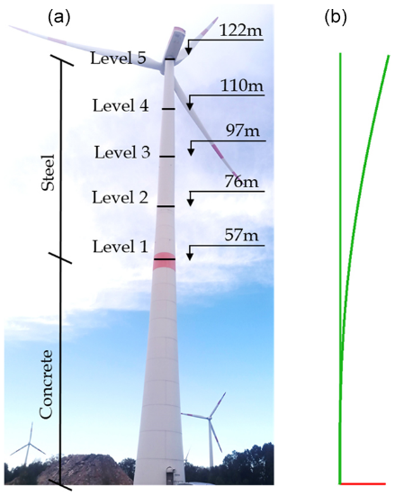
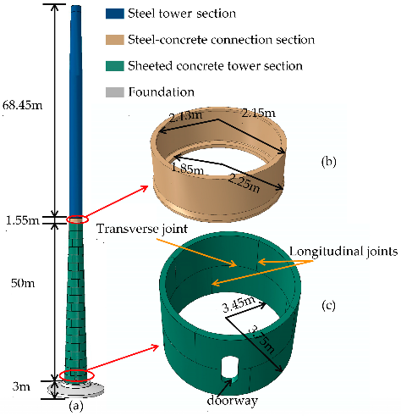
1- A Hybrid tower structure(Concrete bottom, Steel top). 2- Segments of Tubular steel with vertical connections.
For that we came up with two solutions
Fig 1,2: sketches of the hybrid tower concept
Group members: Ibrahim Mostafa, Mohammed Eldemerdash, Kirolls Ghaly
Tower structure team/ Optimus Syria

Slide 5
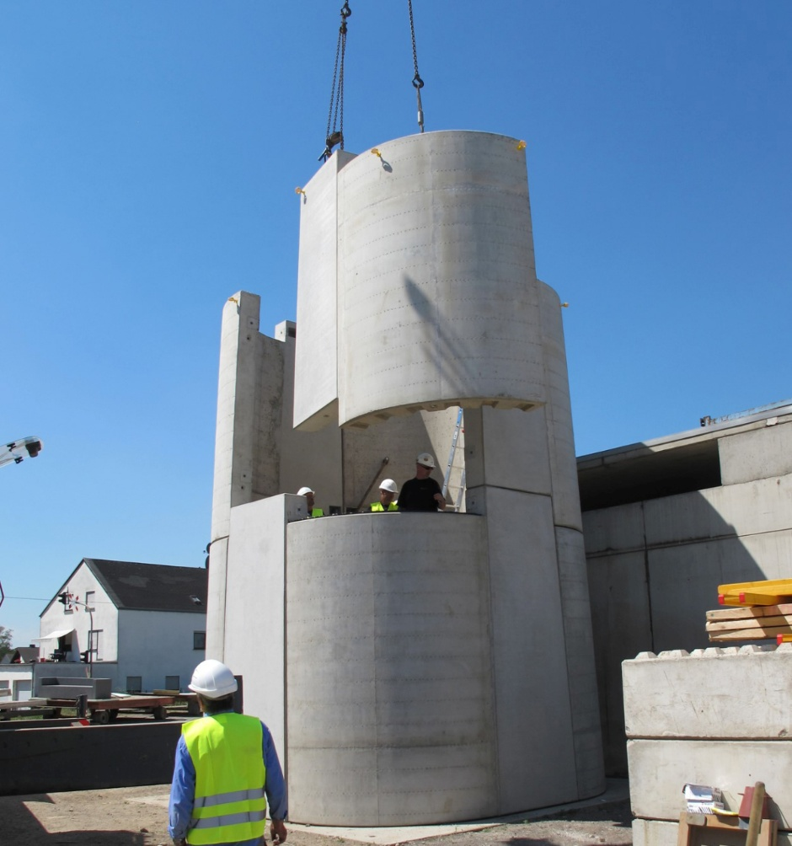
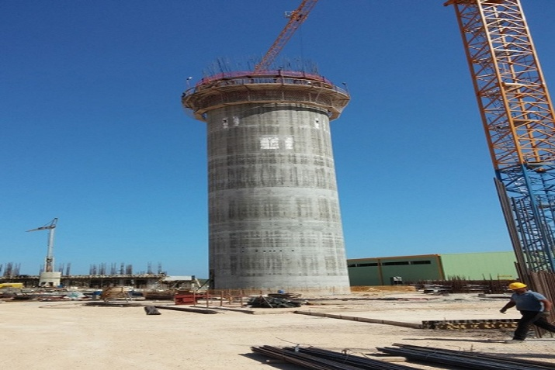
Fig 3: Precast concrete base (segmented) + tubular steel top
The two methods of erecting a hybrid Tower
Fig 4: Cast-in-situ concrete base (slipformed) + tubular steel top
Group members: Ibrahim Mostafa, Mohammed Eldemerdash, Kirolls Ghaly
Tower structure team/ Optimus Syria

Slide 6
- Difficult transport due to heavy, oversized concrete segment. - Long site erection time (formwork, pouring, curing). - Complex concrete-to-steel interface for structural continuity. - Harder inspection and maintenance at the base. - Permanent, less flexible; hard to adapt or modify. - Heavier lifting equipment required. - Less recyclable, harder to dismantle.
Hybrid tower drawbacks
Group members: Ibrahim Mostafa, Mohammed Eldemerdash, Kirolls Ghaly
Tower structure team/ Optimus Syria

Slide 7
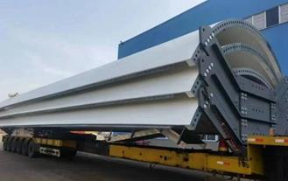
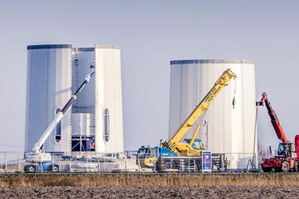
- folded steel “petals” bolted together along vertical seams segments are transported on standard trucks and assembled at site.
Segments of Tubular steel with vertical connections.
Fig 5 : Tubular steel tower segments
Fig 6 : Tubular steel tower construction
Group members: Ibrahim Mostafa, Mohammed Eldemerdash, Kirolls Ghaly
Tower structure team/ Optimus Syria

Slide 8
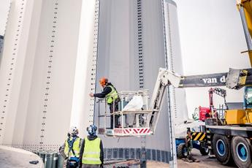
- Easier transport in smaller segments. - Faster erection, no curing time. - Simpler steel-to-steel joints (no hybrid interface). - Easier inspection and maintenance. - Lighter segments reduce crane demands. - Fully recyclable and adaptable supply chain.
Tubular steel segments with vertical connections
Fig 7: steel tower vertical connections
Group members: Ibrahim Mostafa, Mohammed Eldemerdash, Kirolls Ghaly
Tower structure team/ Optimus Syria

Slide 9
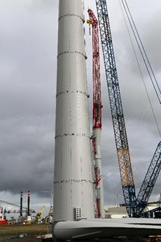
Tubular steel segments with vertical connections
Fig 8: tubular steel tower construction
Ref:
https://www.researchgate.net/
https://www.enercon.de/
Group members: Ibrahim Mostafa, Mohammed Eldemerdash, Kirolls Ghaly
Tower structure team/ Optimus Syria

Slide 10
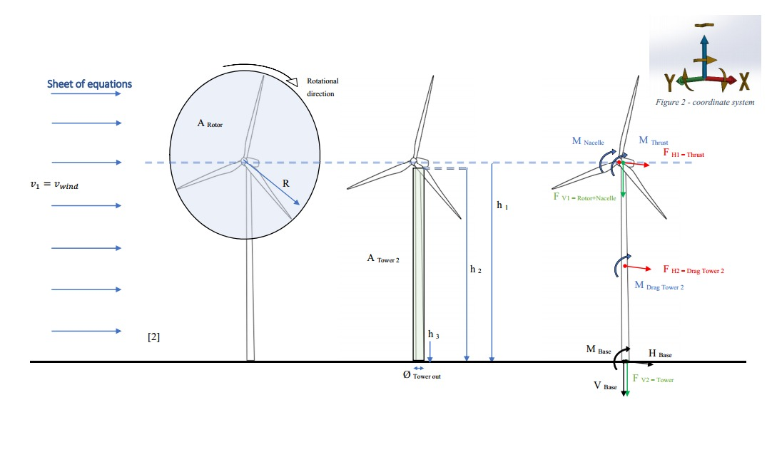
Loads calculations and stress analysis
Fig 9: how the different loads and moments affect the wind turbine
Group members: Ibrahim Mostafa, Mohammed Eldemerdash, Kirolls Ghaly
Tower structure team/ Optimus Syria

Slide 11
Loads calculations and stress analysis
Assumptions
𝜌_{air}=1.225 kg/m³
𝜌_{steel}=7850 kg/m³
(Wind class III) 𝑉=7.5 m/s
𝑔=10 m/s²
𝐷_{rotor}=160 m, 𝐷_{𝑜}=6.0 m, 𝑡=0.027 m
⇒ 𝐷_{𝑖}=5.946
𝐻_{tower}=98 m
ℎ_{hub}=100 m
𝐶_{𝑇}=0.9
𝐶_{𝐷}=0.01 ​
𝑚_{rotor}=110,000 kg
𝑚_{nacelle}=240,000 kg
𝑚_{RNA}=350,000 kg
𝑀_{nacelle}=4200 kN
Reference to data assumptions:
https://www.nrel.gov/wind/data-tools
Group members: Ibrahim Mostafa, Mohammed Eldemerdash, Kirolls Ghaly
Tower structure team/ Optimus Syria

Slide 12
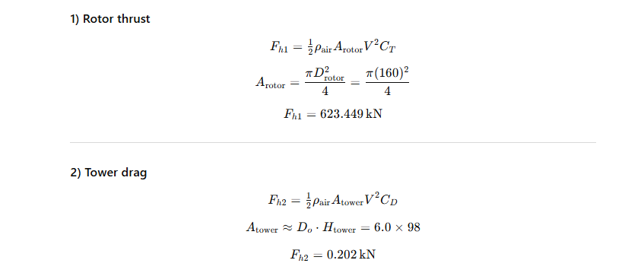
Loads calculations and stress analysis
Group members: Ibrahim Mostafa, Mohammed Eldemerdash, Kirolls Ghaly
Tower structure team/ Optimus Syria

Slide 13
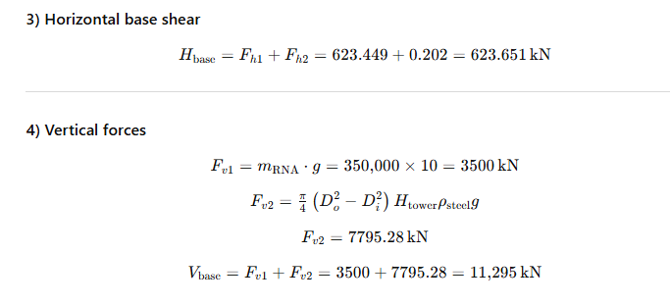
Loads calculations and stress analysis
Group members: Ibrahim Mostafa, Mohammed Eldemerdash, Kirolls Ghaly
Tower structure team/ Optimus Syria

Slide 14
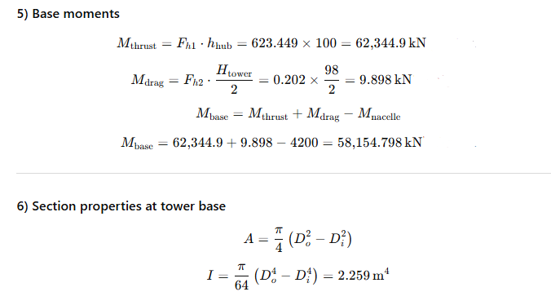
Loads calculations and stress analysis
Group members: Ibrahim Mostafa, Mohammed Eldemerdash, Kirolls Ghaly
Tower structure team/ Optimus Syria

Slide 15
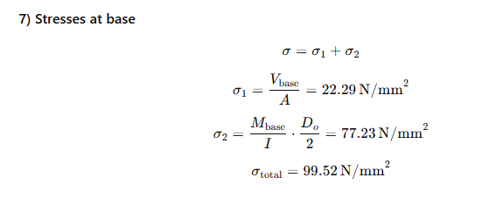
Loads calculations and stress analysis
Group members: Ibrahim Mostafa, Mohammed Eldemerdash, Kirolls Ghaly
Tower structure team/ Optimus Syria

Slide 16
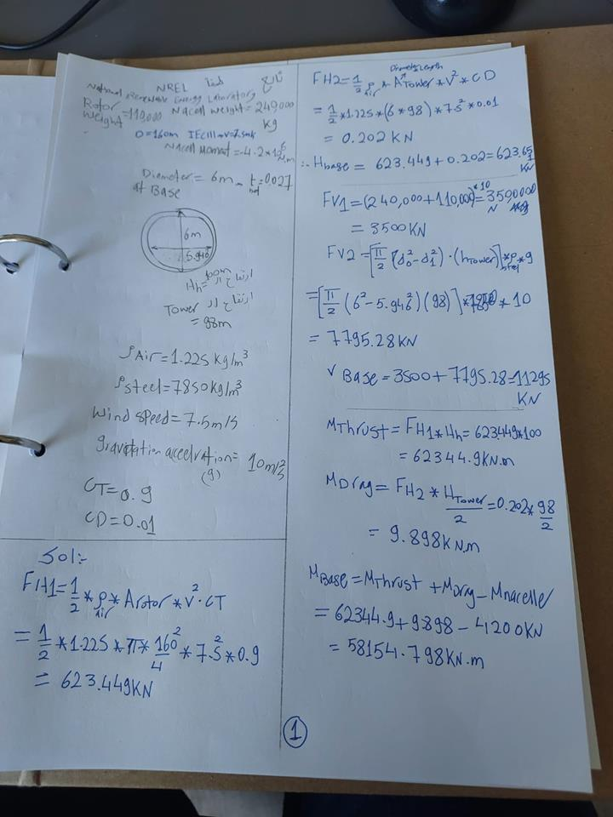
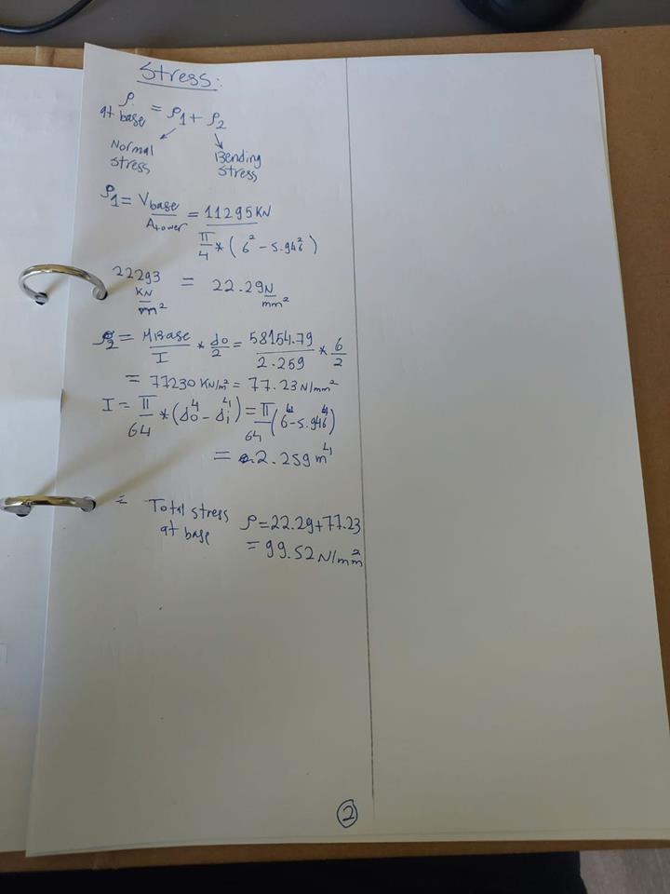
Loads calculations and stress analysis
Fig 10,11: Original handwritten calculations
Group members: Ibrahim Mostafa, Mohammed Eldemerdash, Kirolls Ghaly
Tower structure team/ Optimus Syria

Slide 17
work distribution
Mohammed Eldemerdash:
loads and stress calculations.
Editing and presenting.
Ibrahim Mostafa:
Revision of the calculations.
Finding solutions for transportation of the steel tower.
Kirollos Ghaly:
- no input
Group members: Ibrahim Mostafa, Mohammed Eldemerdash, Kirolls Ghaly
Tower structure team/ Optimus Syria

